Slide 1
Why use nonlinear models?
Fernando Miguez
May 1st
Lunchinators/Ragronomists

Slide 2
Outline
What do I mean by nonlinear models?
What options do we have?
How can we extend a nonlinear model?
How can we assess uncertainty?

Slide 3
Outline
What do I mean by nonlinear models?
What options do we have?
How can we extend a nonlinear model?
How can we assess uncertainty?

Slide 4
What do I mean by a nonlinear model?

Slide 5
What do I mean by a nonlinear model?

Slide 6
Outline
What do I mean by nonlinear models?
What options do we have?
How can we extend a nonlinear model?
How can we assess uncertainty?

Slide 7
Outline
What do I mean by nonlinear models?
What options do we have?
Example: Orange trees
How can we extend a nonlinear model?
How can we assess uncertainty?

Slide 8
Orange trees

Slide 9
What options do we have?
Polynomials

Slide 10
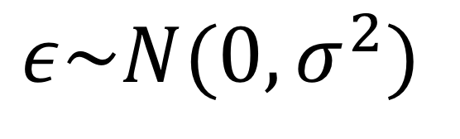
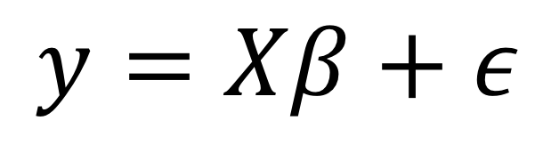
What options do we have?
Polynomials
$$y=Xβ+ε$$
$$ε\sim N(0,σ^{2})$$

Slide 11
Normality
When assessing the normality of the raw data very often we can confuse lack of normality with nonlinearity or other structure in the data
Transformations are not generally recommended
Sometimes the right choice, careful decision
Today there are better alternatives to simple transformations

Slide 12
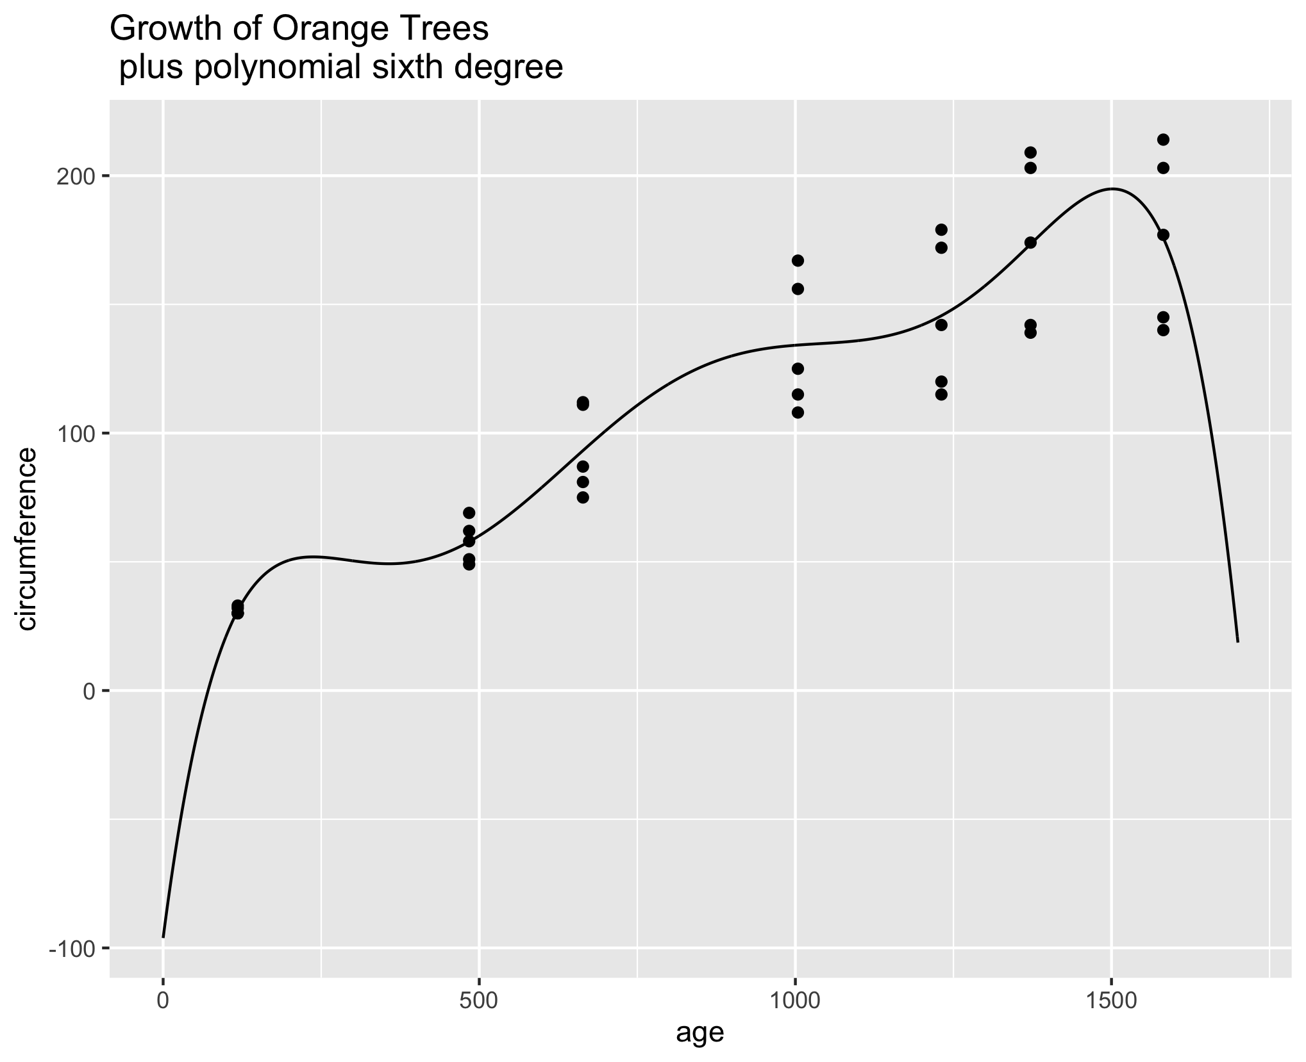
Polynomial

Slide 13
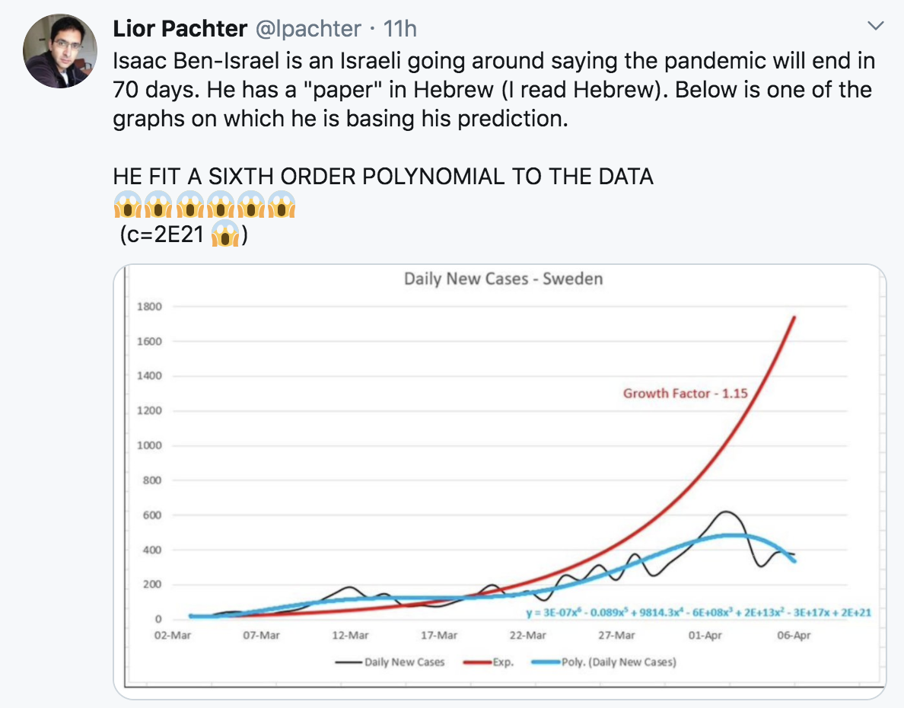

Slide 14
Polynomials
Disadvantages
Advantages
Are still linear models
Easy to fit
Easy to “understand” mathematically
Interpolating (not good)
Extrapolating (bad)
Interpretation (difficult)
Unstable parameters
Questionable predictive ability

Slide 15
What options do we have?
Polynomials
“Classical” nonlinear models

Slide 16
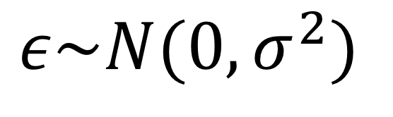
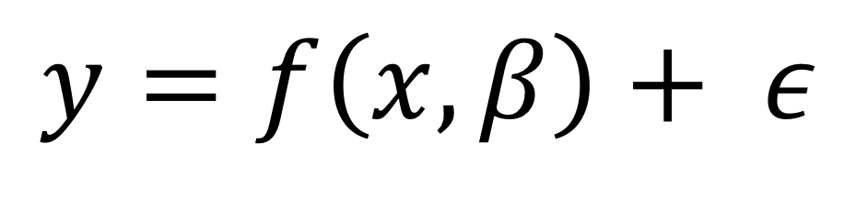
What options do we have?
Polynomials
“Classical” nonlinear models
$$y=f\left(x,β\right)+ ε$$
$$ε\sim N(0,σ^{2})$$

Slide 17
What options do we have?
Polynomials
“Classical” nonlinear models
Example: logistic growth function

Slide 18
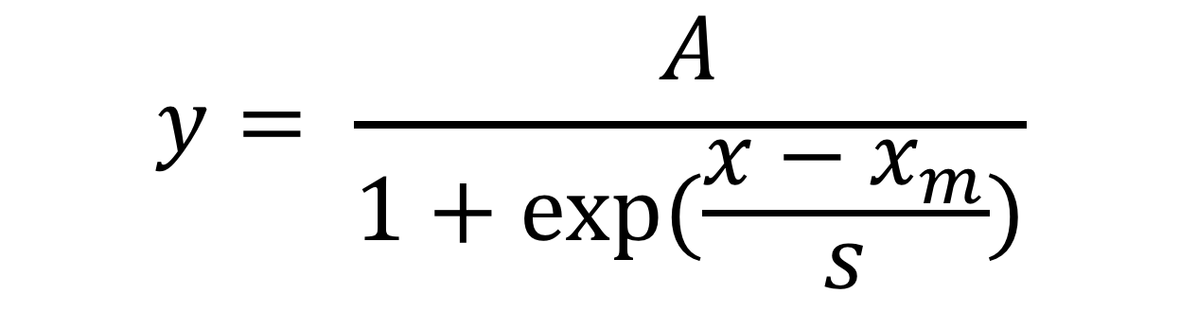
Example: Logistic function
$$y= \frac{A}{1+exp⁡(\frac{x−x_{m}}{s})}$$

Slide 19
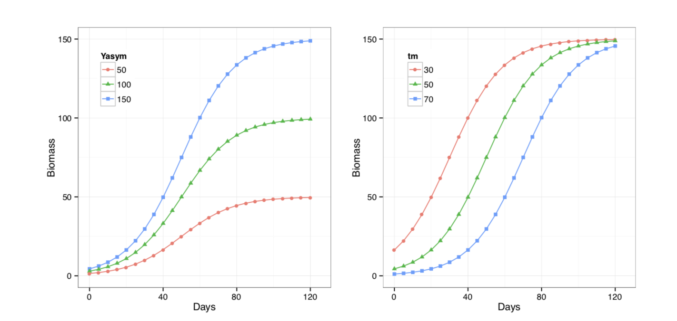
Example: Logistic function

Slide 20
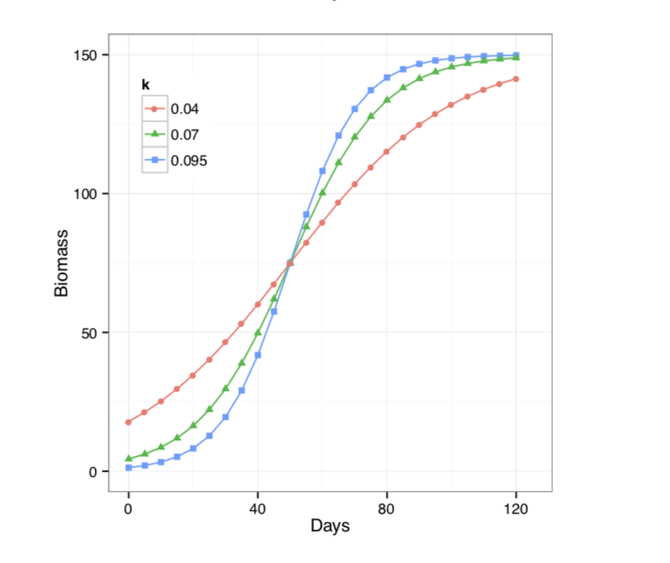
Example: Logistic function
s

Slide 21
“Classical” nonlinear models
Disadvantages
Advantages
Theoretical derivation (some)
Parsimony (few parameters)
Parameters have a direct interpretation
Compared to polynomials:
interpolation (good)
extrapolation (better)
stable parameters
No analytical solution (need starting values)
Harder to fit “complex” nonlinear models
Which model to choose?

Slide 22
“Classical” nonlinear models
Disadvantages
Advantages
Are derived from theoretical principles
Parameters have a direct interpretation
Compared to polynomials:
interpolation (good)
extrapolation (better)
stable parameters
Need starting values (no analytical solution)
Harder to fit “complex” nonlinear models
Which model to choose?

Slide 23
What options do we have?
Polynomials
“Classical” nonlinear models
Example: logistic growth function
Intro paper

Slide 24
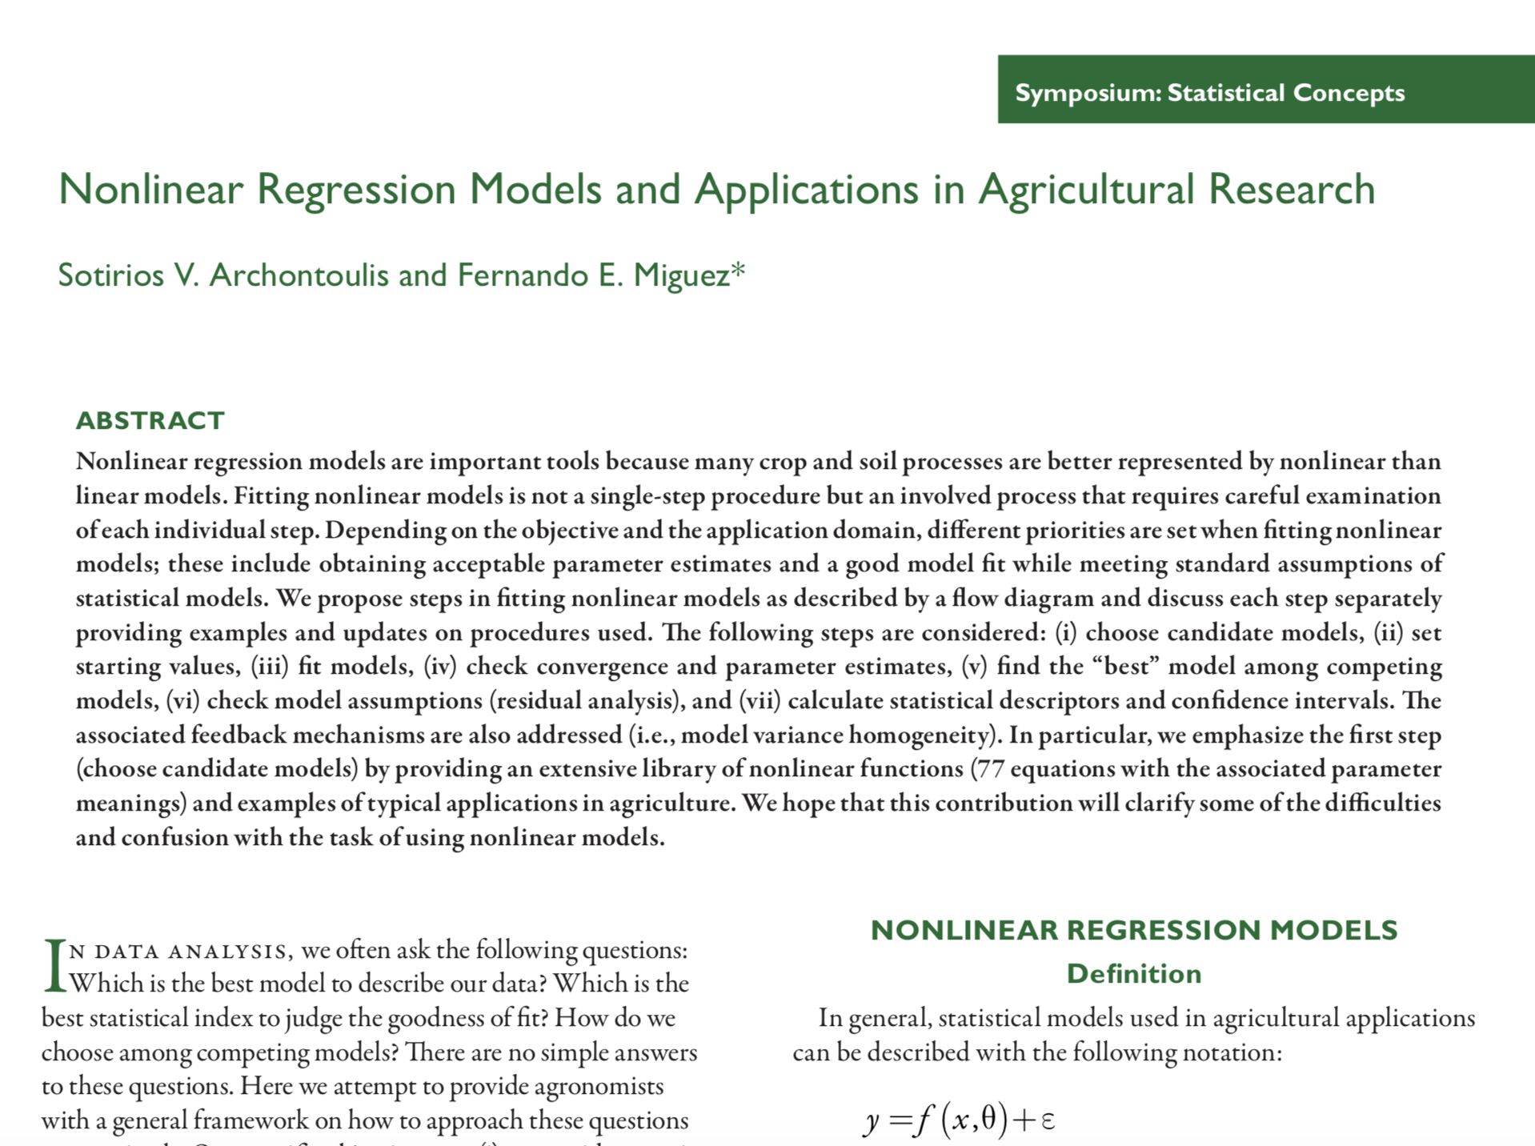
https://doi.org/10.2134/agronj2012.0506

Slide 25
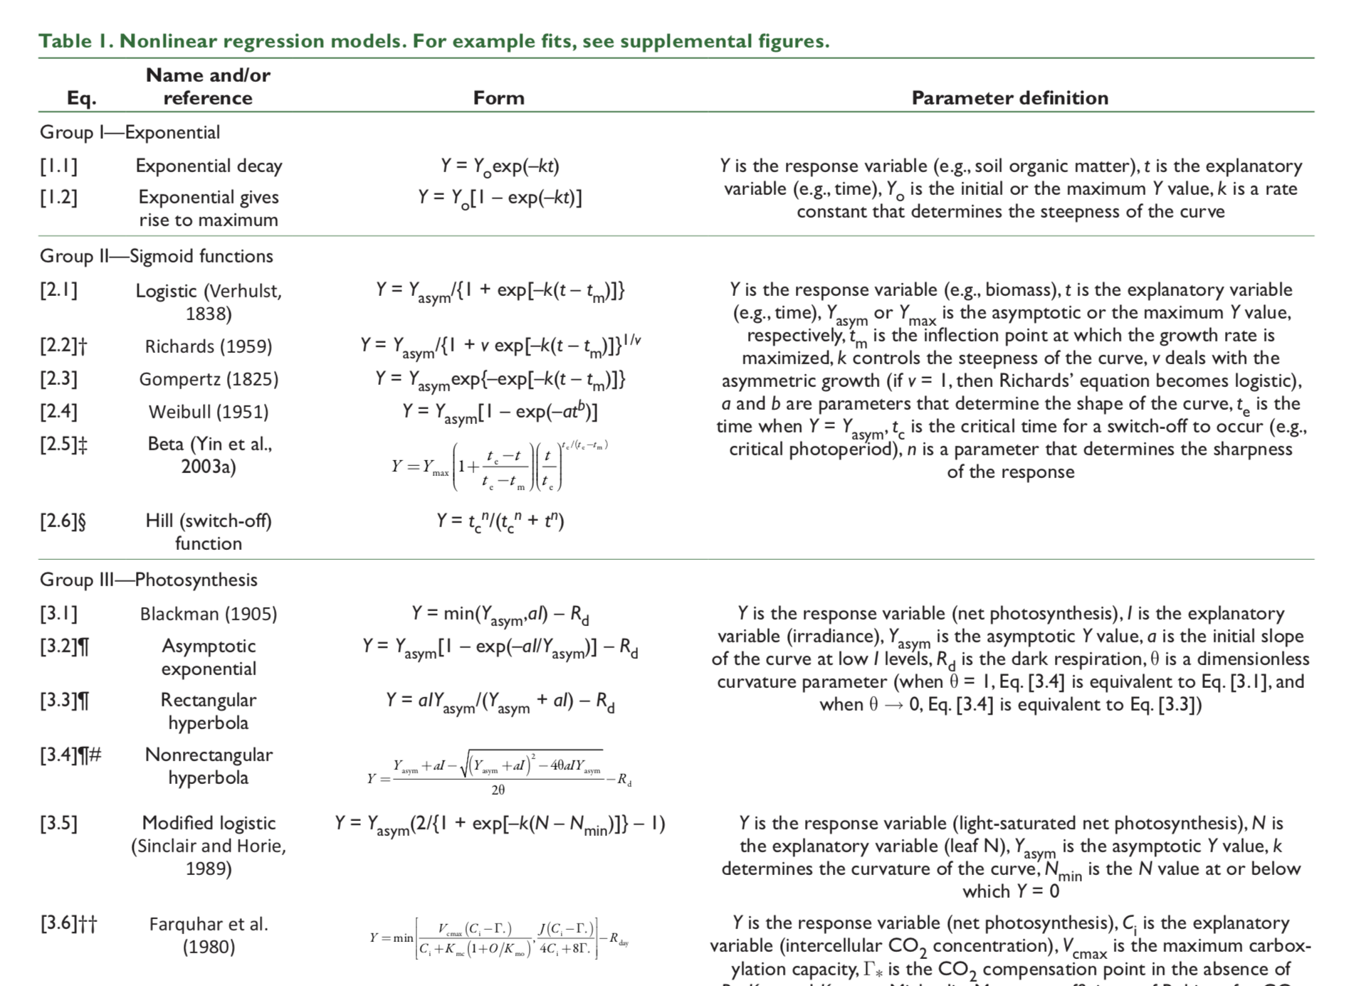

Slide 26
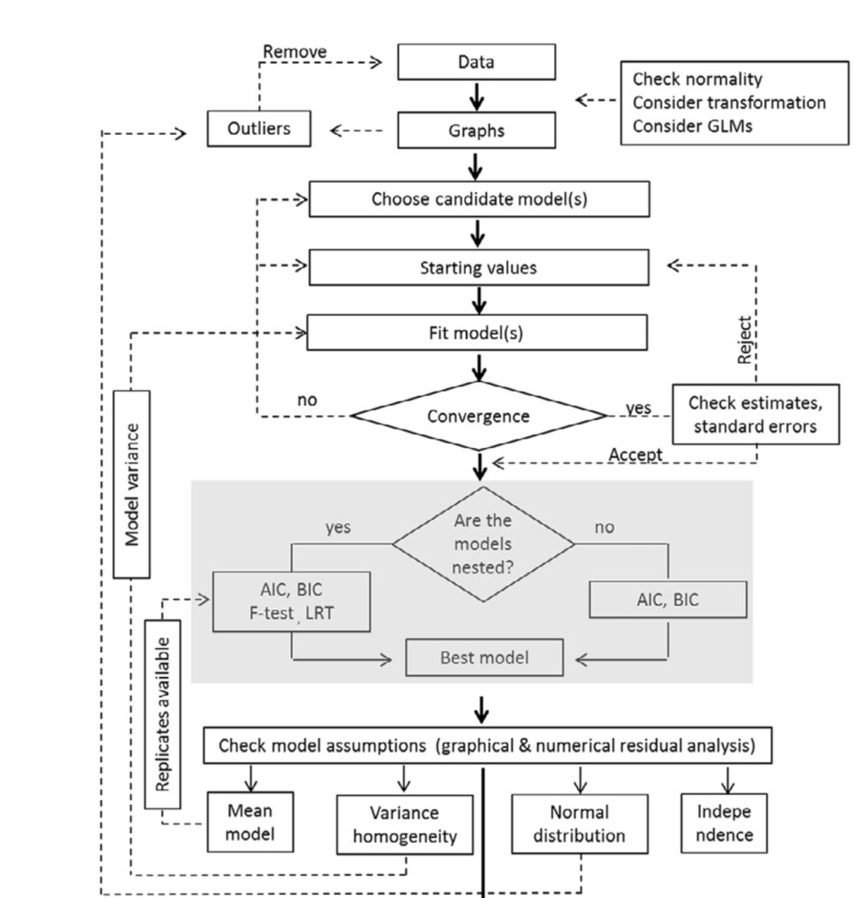

Slide 27
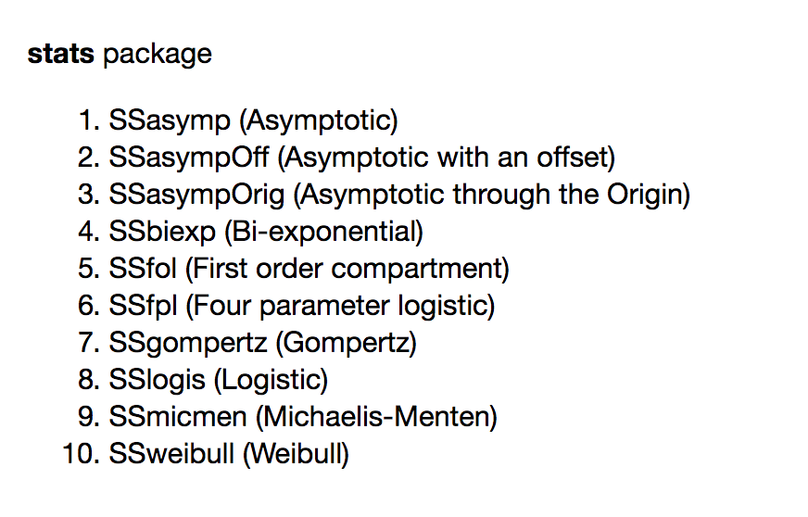
“Classical” nonlinear models (in R)
Starting values are tricky (it’s an “art”)
base package “stats” provides “self start” functions
It also supplies derivatives

Slide 28
What options do we have?
Polynomials
“Classical” nonlinear models
Example: logistic growth function
Intro paper
Quick simple examples

Slide 29
Yield response to N fertilizer
This model has a “break-point” which is easily handled as a nonlinear parameter

Slide 30
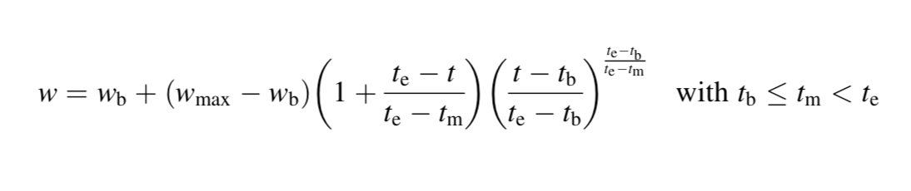
Beta growth function

Slide 31
Response to temperature
Parameters have meaningful interpretations
w.max maximum growth rate
t.e temperature at which w.max is attained
t.m time at which half of maximum GR is attained

Slide 32
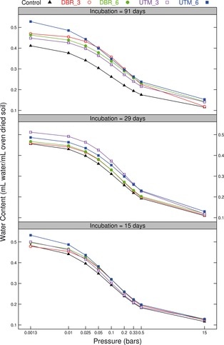
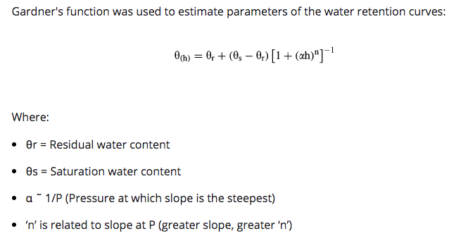
Soil physics application
Different biochar applications
Different incubation times
We want to capture the dynamics AND also investigate treatment effects
Basso, Miguez, et al. (2013). https://doi.org/10.1111/gcbb.12026

Slide 33
“Classical” nonlinear models
Short examples
Yield N response (break-point)
Plant response to temperature (beta)
Soil water retention curves (Gardner)

Slide 34
“Classical” nonlinear models
Short examples
Yield N response (break-point)
Plant response to temperature (beta)
Soil water retention curves (Gardner)
Orange trees (Logistic)

Slide 35
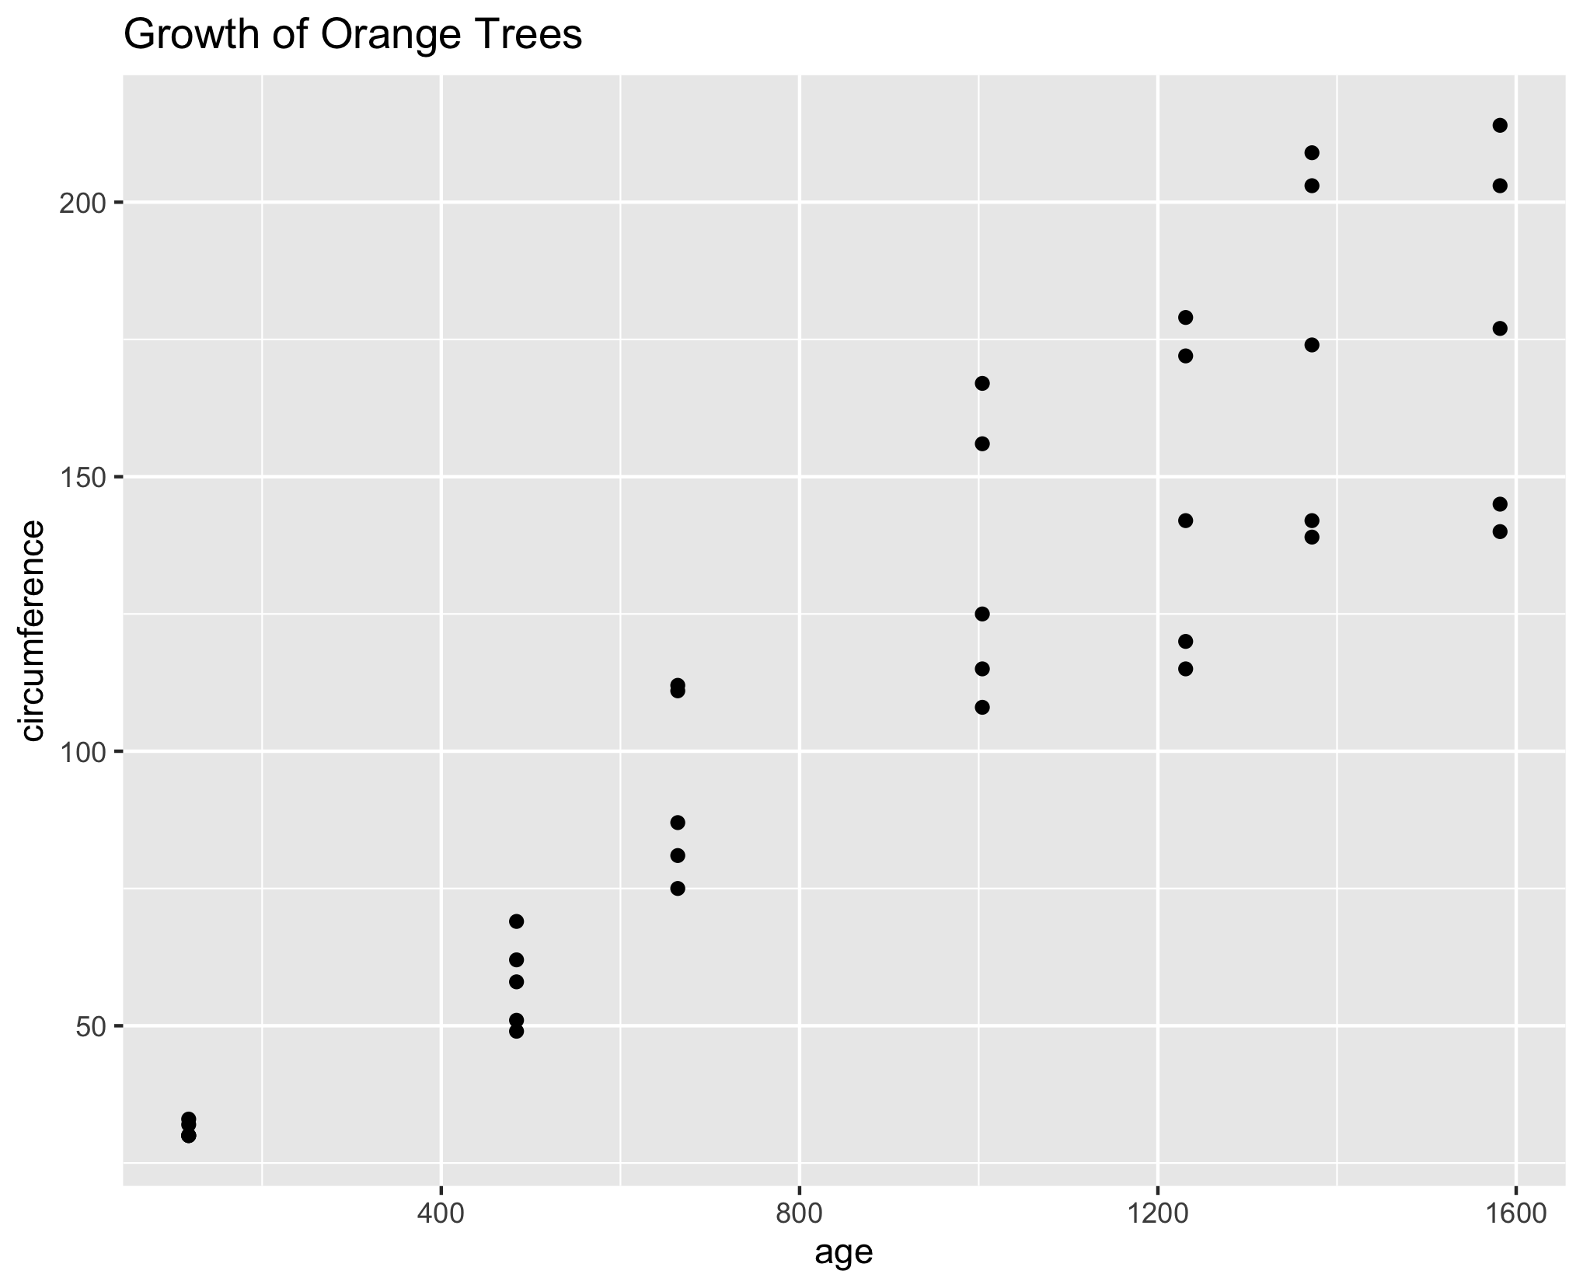
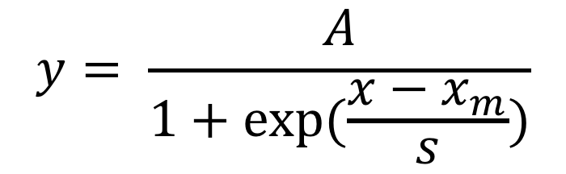
Growth of Orange trees
$$y= \frac{A}{1+exp⁡(\frac{x−x_{m}}{s})}$$

Slide 36
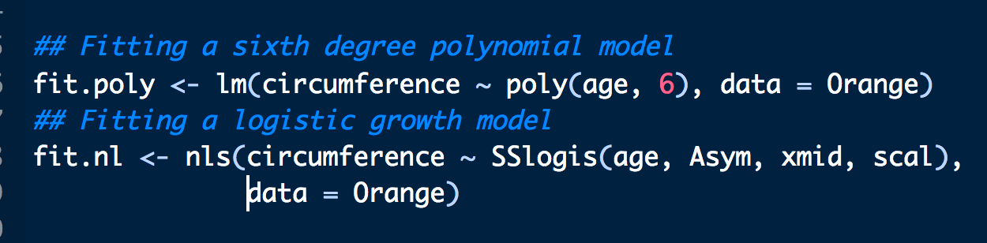
R code
No need to worry about starting values or derivatives

Slide 37
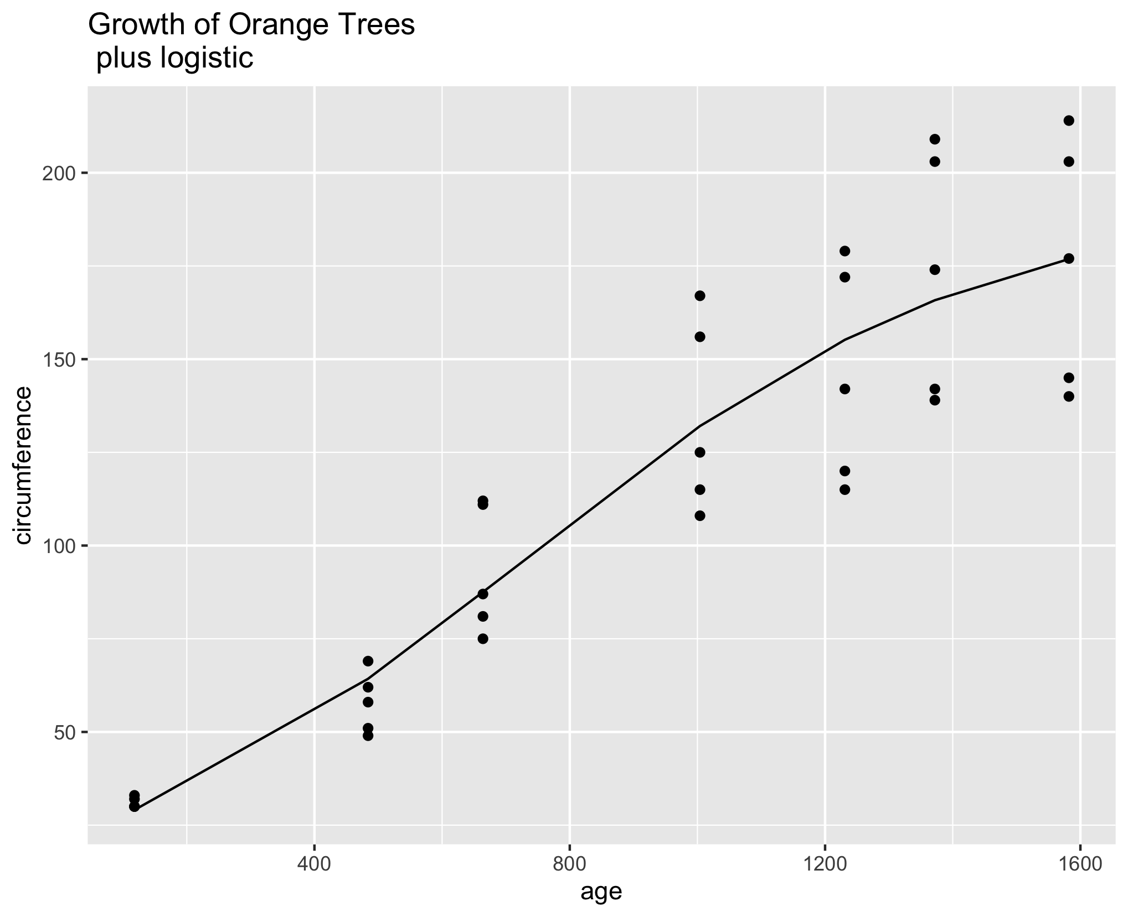
Orange tree

Slide 38
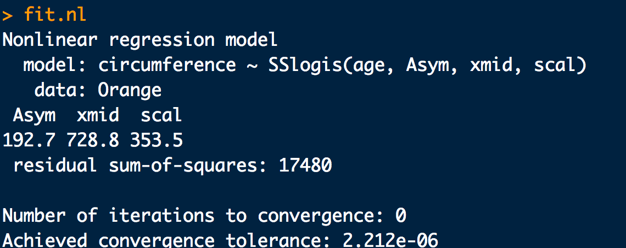
Orange tree fit

Slide 39
What options do we have?
Polynomials
“Classical” nonlinear models
Example: logistic growth function
Intro paper
Quick simple examples
nlraa R package

Slide 40
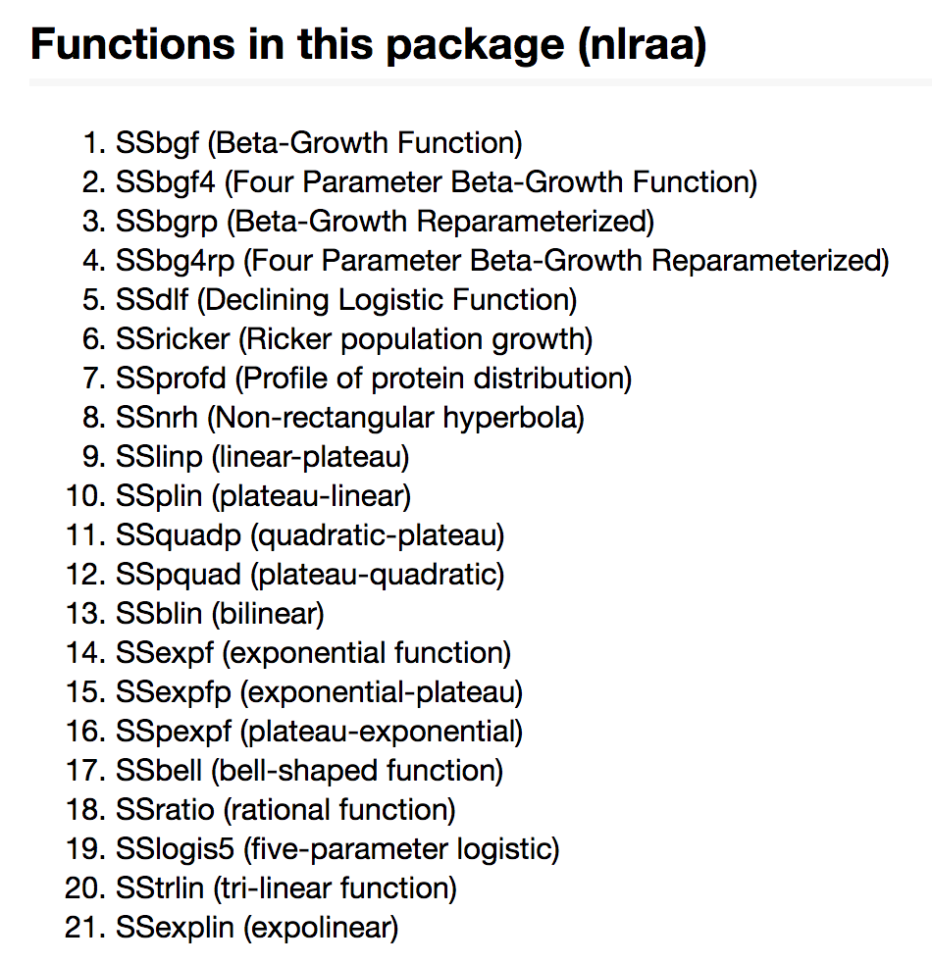
nlraa (0.65) package for nonlinear regression
https://github.com/femiguez/nlraa

Slide 41
Outline
What do I mean by nonlinear models?
What options do we have?
How can we extend a nonlinear model?
How can we assess uncertainty?

Slide 42
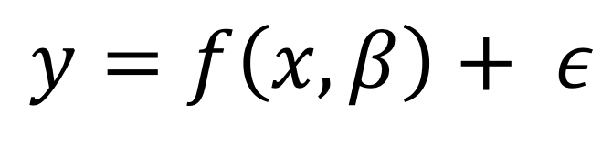
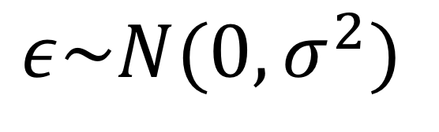
Orange tree
$$y=f\left(x,β\right)+ ε$$
$$ε\sim N(0,σ^{2})$$

Slide 43
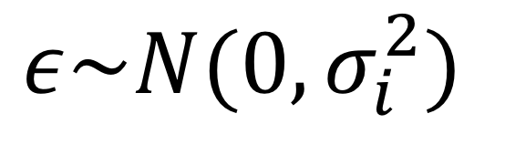
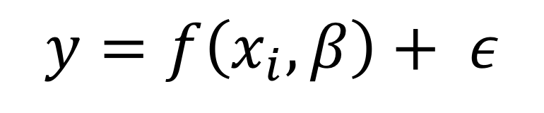
Extending the nonlinear model
$$y=f\left(x_{i},β\right)+ ε$$
$$ε\sim N(0,σ_{i}^{2})$$

Slide 44
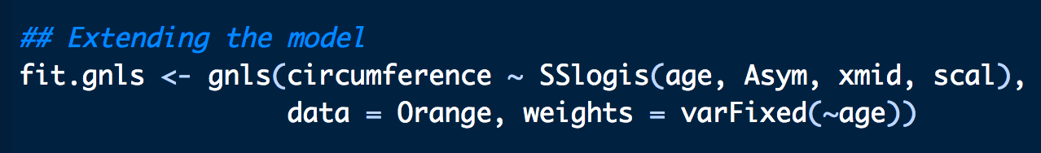
Extending the nonlinear model (nlme)

Slide 45
Residuals
Before

Slide 46
Residuals
Before

Slide 47
Residuals (after)
After

Slide 48
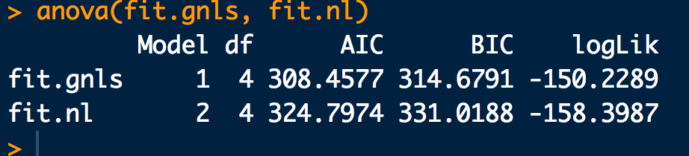
Residuals (after)
After

Slide 49
Outline
What do I mean by nonlinear models?
What options do we have?
How can we extend a nonlinear model?
How can we assess uncertainty?

Slide 50
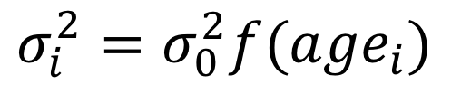
Uncertainty: option 1
Boostrap the mean function
$$σ_{i}^{2}=σ_{0}^{2}f({age}_{i})$$

Slide 51
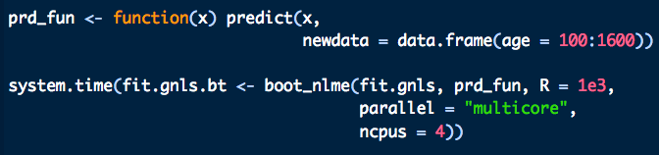
nlraa: Bootstrap gnls (R code)

Slide 52
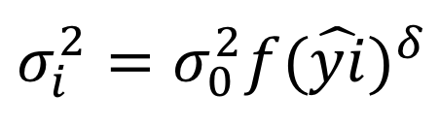
Bootstrap
$$σ_{i}^{2}=σ_{0}^{2}f{(\hat{yi})}^{δ}$$

Slide 53
Option 2: NL quantile regression
Quantile nonlinear regression (quantreg)
Useful for describing the distribution of observations

Slide 54
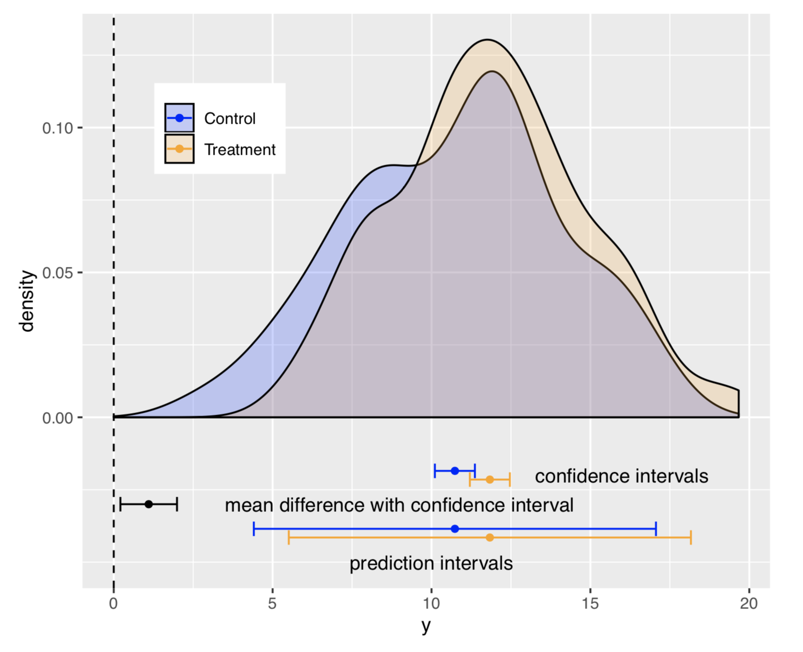

Slide 55
Option 2: NL quantile regression
Quantile nonlinear regression (quantreg)
Useful for describing the distribution of observations

Slide 56
Summary
What do I mean by nonlinear models?
What options do we have?
How can we extend a nonlinear model?
How can we assess uncertainty?
Note: Had to leave out GAMs, Mixed (next time)

Slide 57
Resources
nlraa: https://CRAN.R-project.org/package=nlraa
nlraa GitHub: https://github.com/femiguez/nlraa
email: femiguez@iastate.edu
Code and slides in lunchinatoRs
Thank you!
Questions?

